Slide 1
Evaluation Report

Slide 2
Test Execution of the application
Application Under Test – Mobile Assignment v1.0
Device used for testing – Pixel 2XL Emulator (Android 9)
No. of test cases executed
Test Cases Executed | Test Cases Passed | Test Cases Failed | Test Steps Executed | Test Steps Passed | Test Steps Failed
8 | 4 | 4 | 24 | 20 | 4
No. of defects found and their Severity
Defects Found | Critical | Major | Minor
4 | 3 | 1 | 0

Slide 3
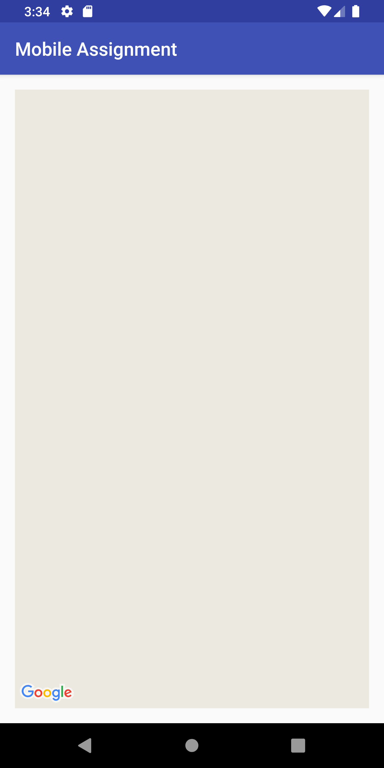
Issues with the Usability of the Application:
There is no Title defined and displayed on a screen, For example here we are on the Map landing screen but the title reads ‘Mobile Assignment’.
On the other hand there is no breadcrumb on the screen as well, which can intern show the hierarchy of the application and which page the user is currently on.
Map landing page should alternatively also display the the city or place that user has selected and also a few details about the place for a better user experience.
The above points make the user experience of the application very confusing and the usability very poor.

Slide 4

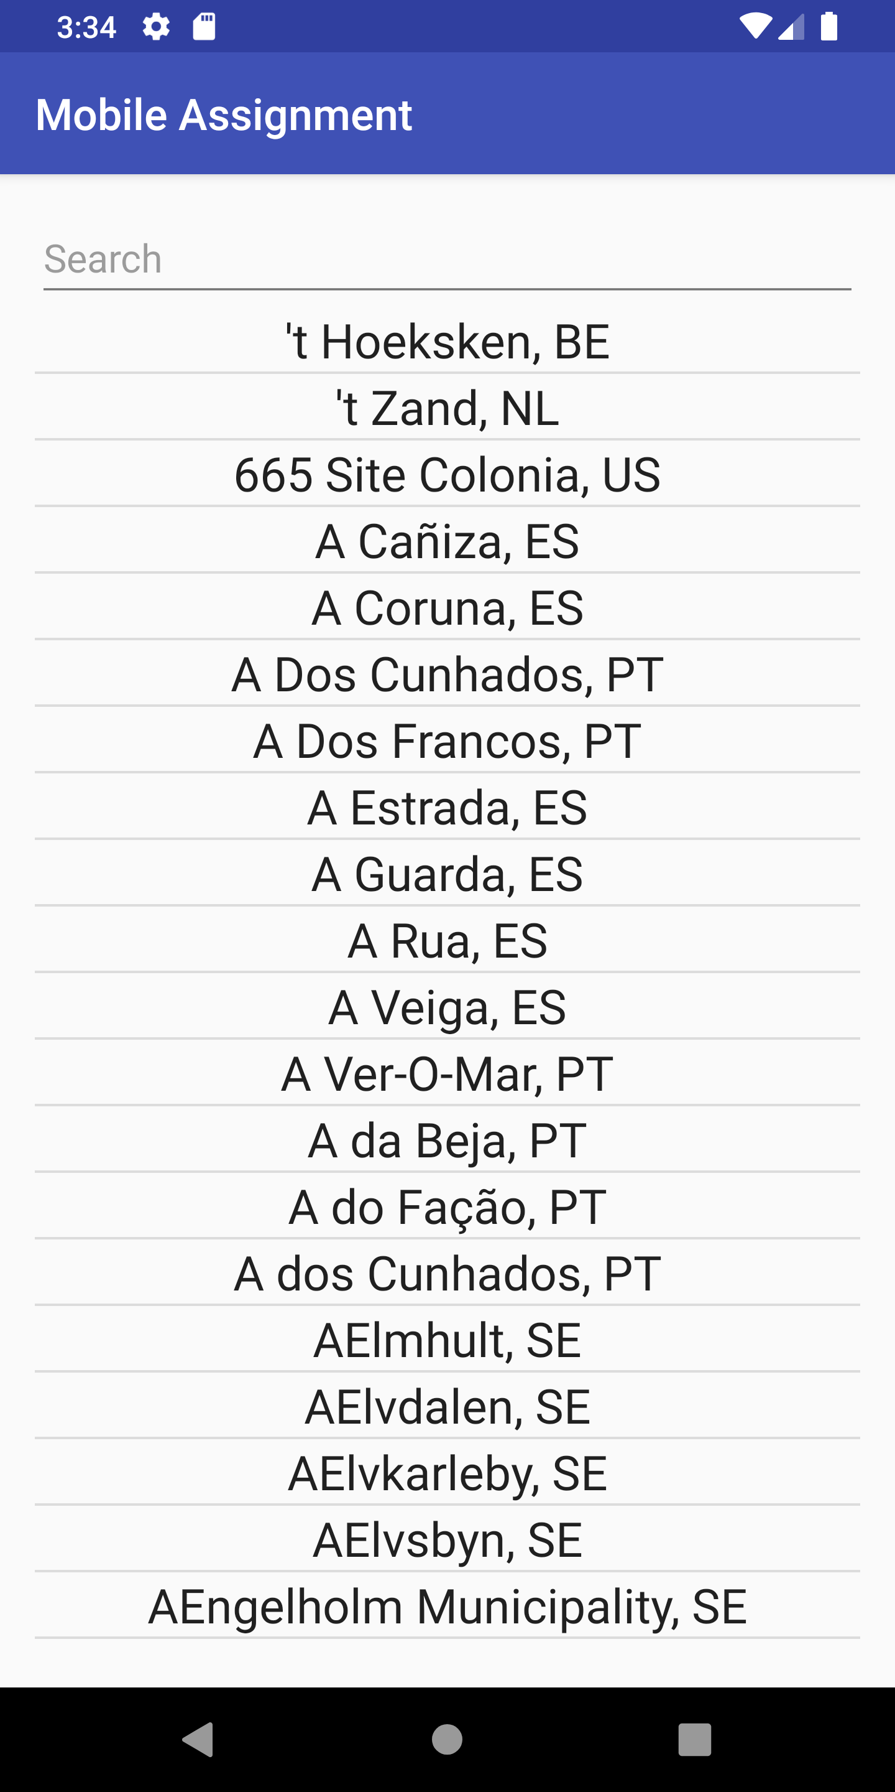
Issues with the Design of the Application:
The Design of the Application is very simplistic and not at all Intuitive.
The Home page itself is not self explanatory, Simple details like a label for the search box “Search a city here” or a label for the list of cities like “cities in the country” would just make the design a little better and appealing.
These points just suggest that the design of the application is not Interactive enough for the user.

Slide 5
Risks and Recommendations
Risks | Recommendations
Poor Usability and Design will lead to a poor User experience and therefore poor User ratings | Usability and Design of the application has to be thought through and should remain consistent on both platforms – iOS and Android
The Acceptance criteria also is not precise and therefore the test scenarios designed were based on Assumptions | Acceptance criteria should be bifurcated in user stories and have a concise Outcome/Expectation of a functionality
Since the design of the application is vague there will be inconsistency across screen sizes and OS’s | Design of the application should be developed and mapped to invision so that the screens can be developed accordingly
Testing on Emulators and Simulators | Testing should be done on actual devices instead of Emulators to validate the actual performance and design of the application

